Slide 1

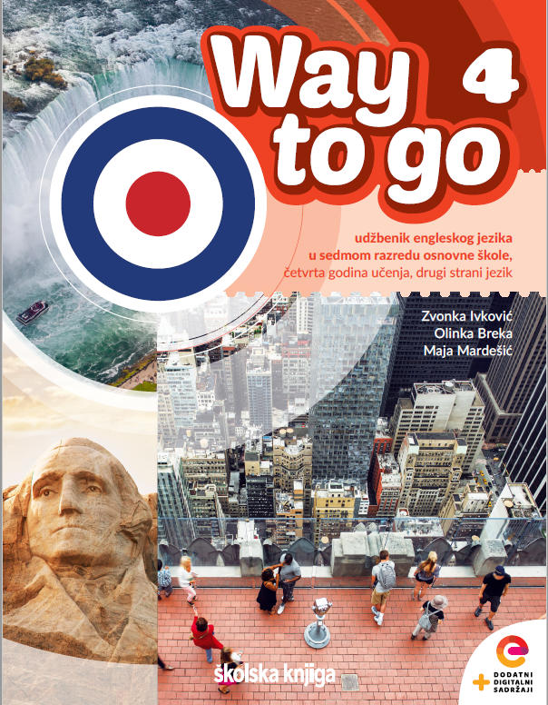
Unit 2: Lesson 6
With flying colours

Slide 2
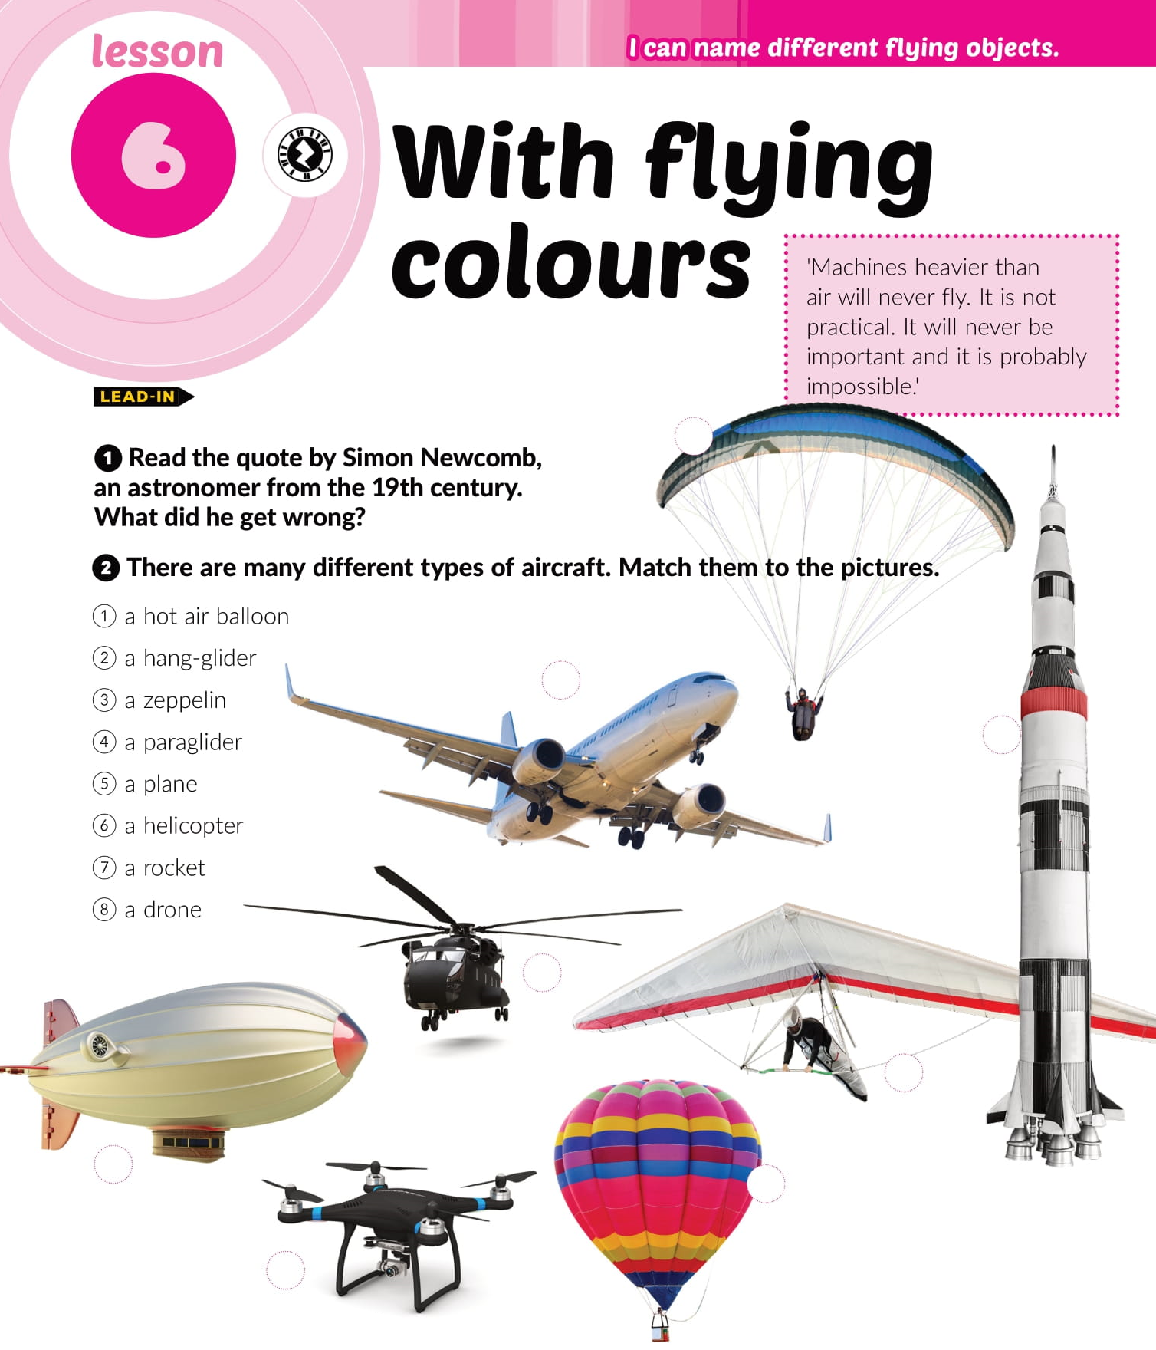
4
5
7
6
2
3
1
8

Slide 3
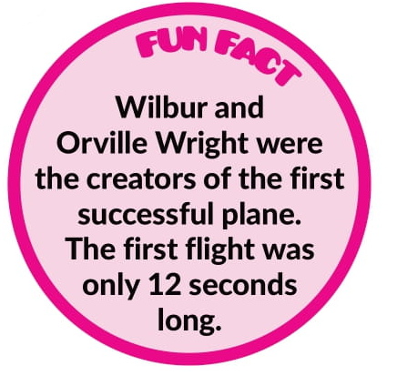
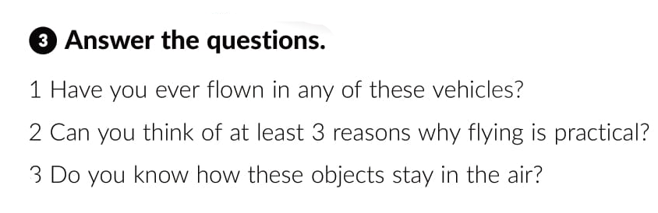

Slide 4
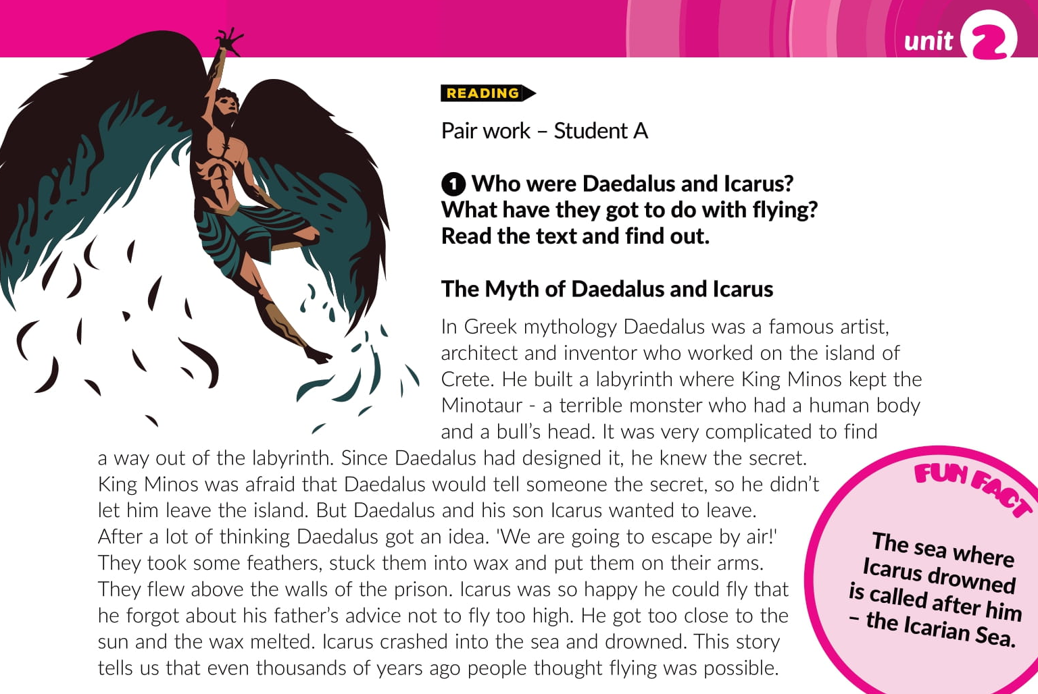

Slide 5
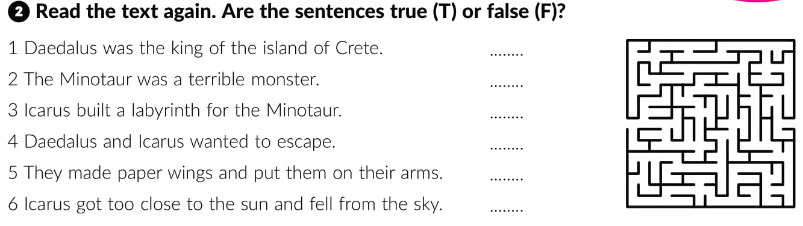
F
T
F
T
F
T

Slide 6
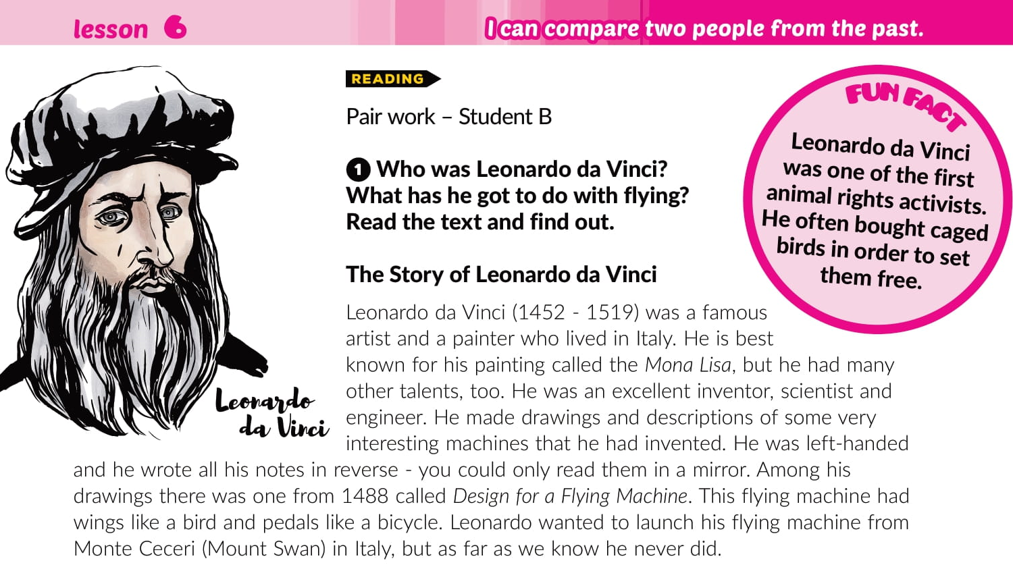

Slide 7
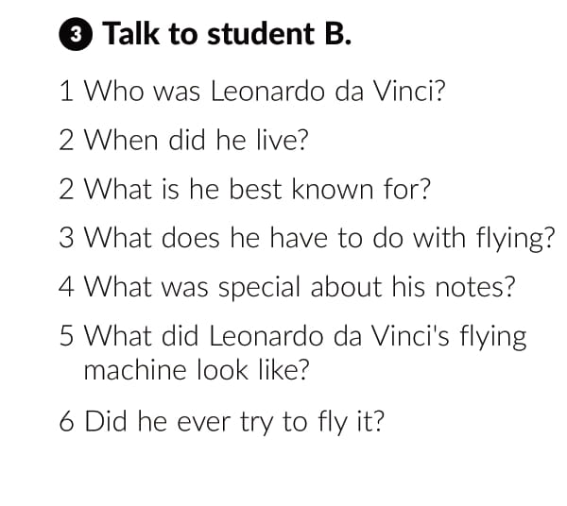

Slide 8
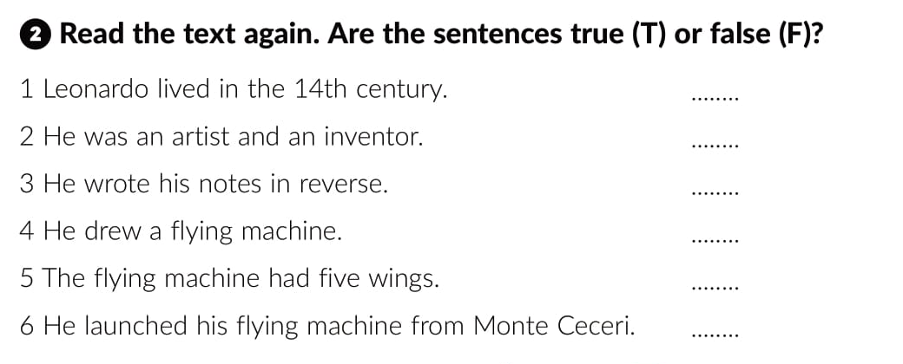
F
T
T
T
F
F

Slide 9
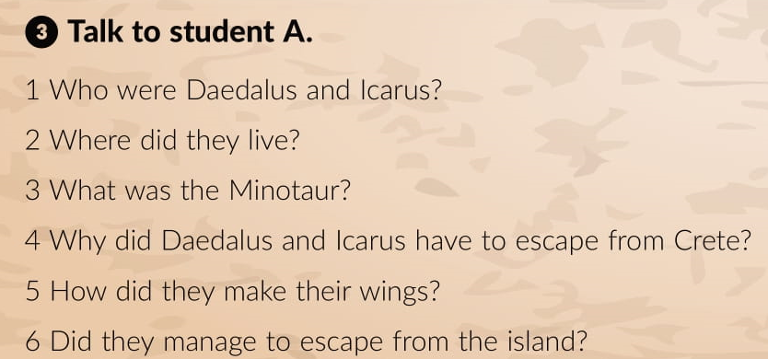
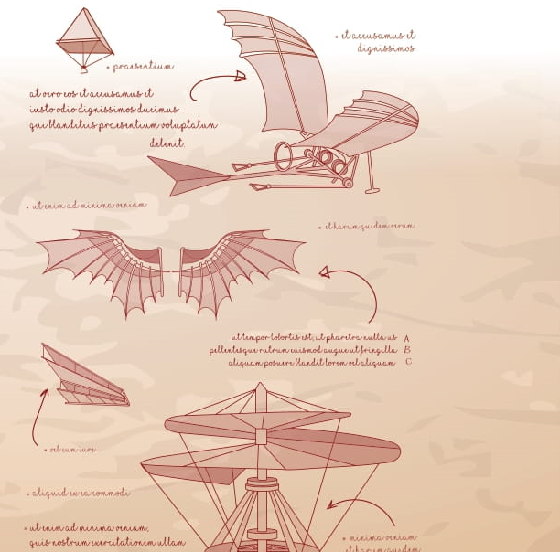

Slide 10
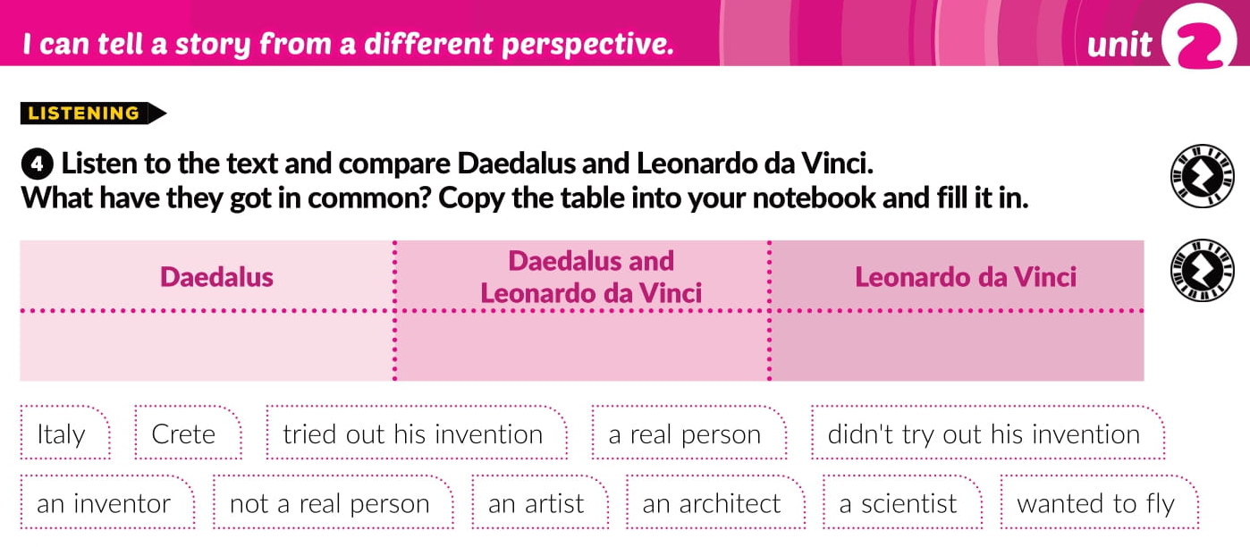
https://www.e-sfera.hr/dodatni-digitalni-sadrzaji/aa2f10bb-5925-42d4-8337-a323a2b401c8/
Crete, tried out his invention, not a real person, an architect,
an inventor, an artist; wanted to fly
Italy, a real person, didn’t try out his invention, a scientist

Slide 11
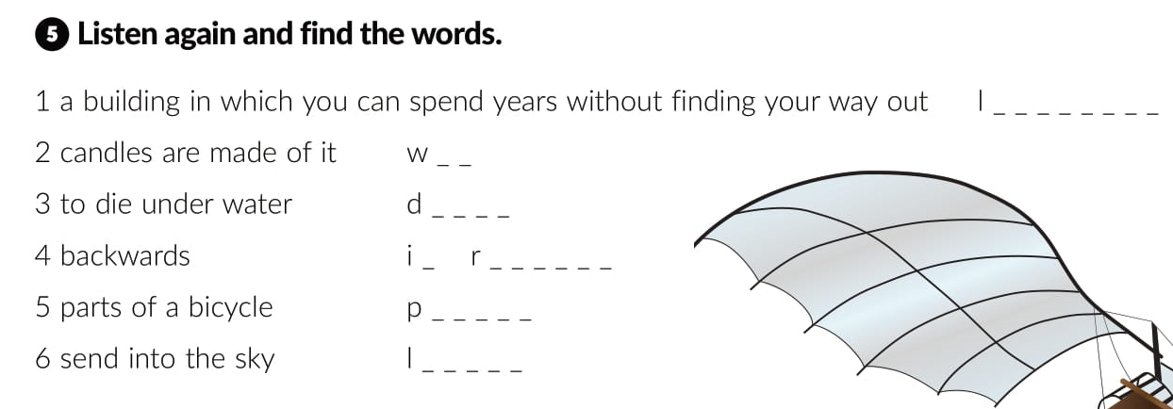
https://www.e-sfera.hr/dodatni-digitalni-sadrzaji/aa2f10bb-5925-42d4-8337-a323a2b401c8/
a b y r i n t h
a x
r o w n
n
e v e r s e
e d a l s
a u n c h

Slide 12
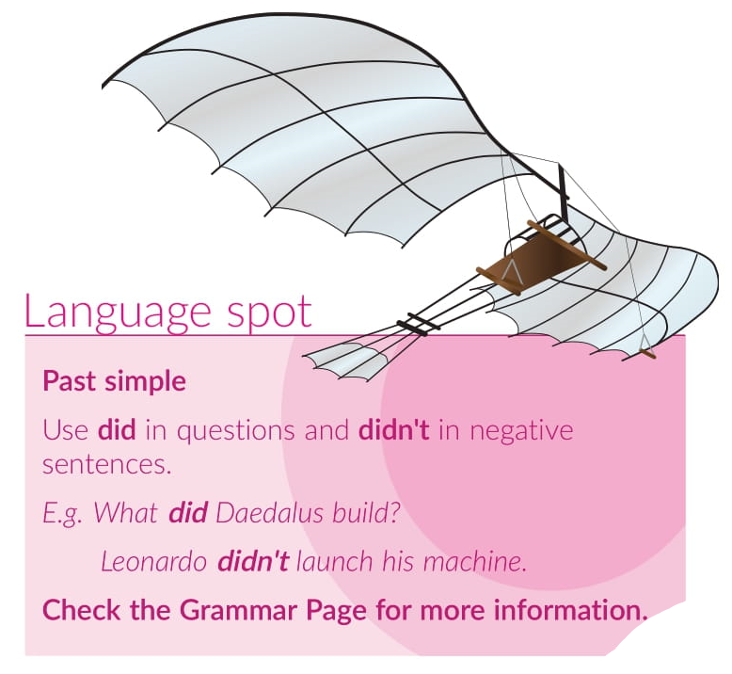

Slide 13
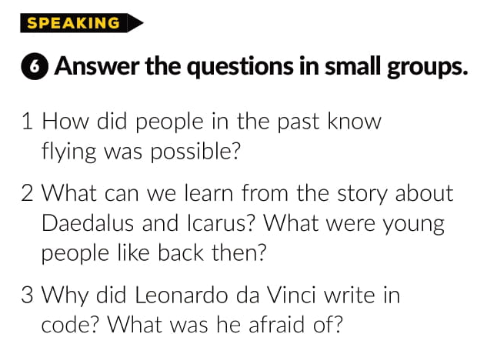

Slide 14
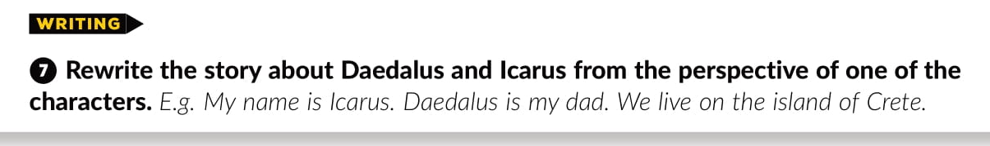
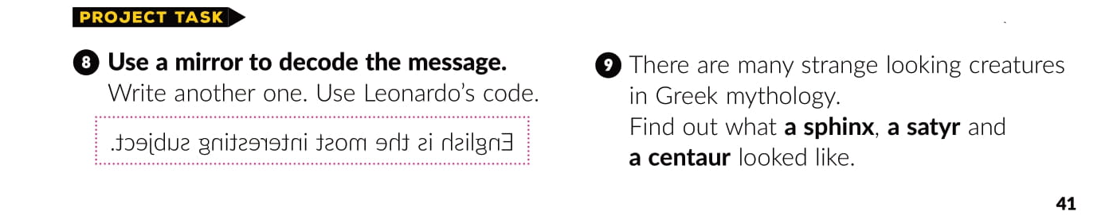

Slide 15
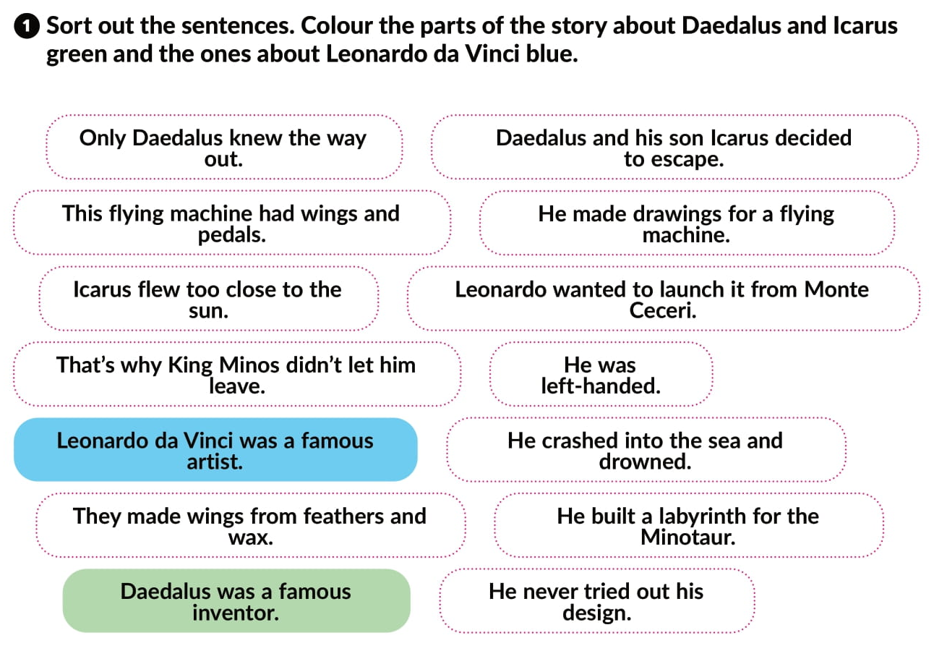
Workbook
p. 24

Slide 16
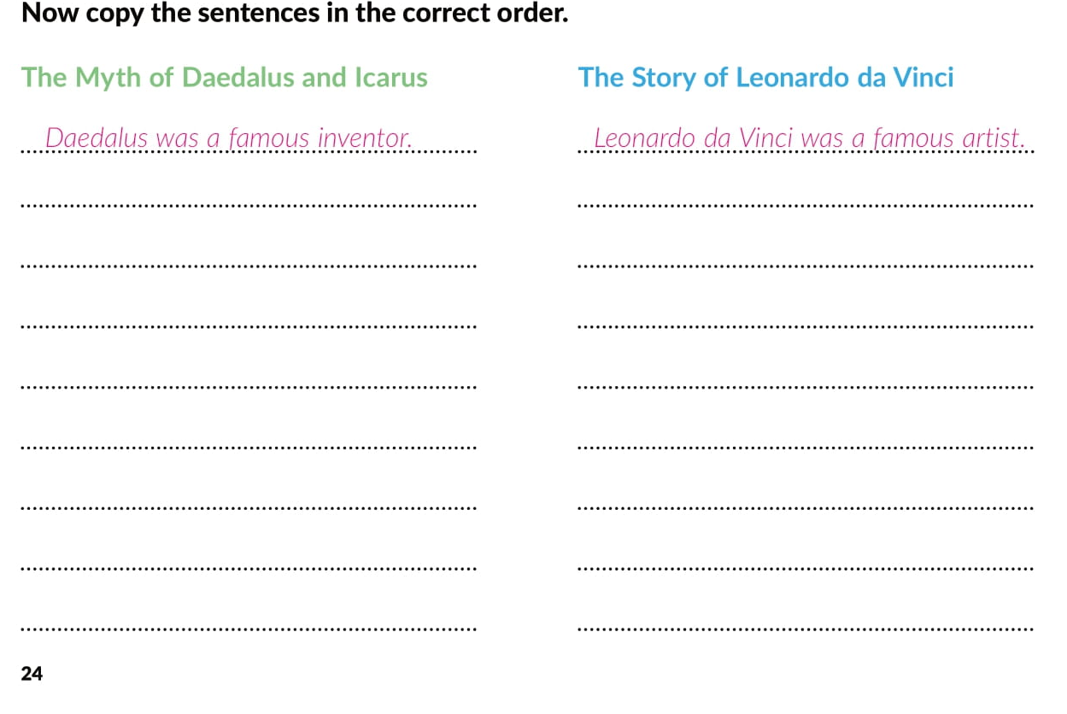
He built a labyrinth for the Minotaur.
He made drawings for a flying machine.
Only Daedalus knew the way out.
He was left-handed.
That’s why King Minos didn’t let him leave.
The flying machine had wings and pedals.
Daedalus and his son Icarus decided to escape.
Leonardo wanted to launch it from Monte Ceceri.
They made wings from feathers and wax.
He never tried out his design.
Icarus flew too close the sun.
He crashed into the sea and drowned.

Slide 17
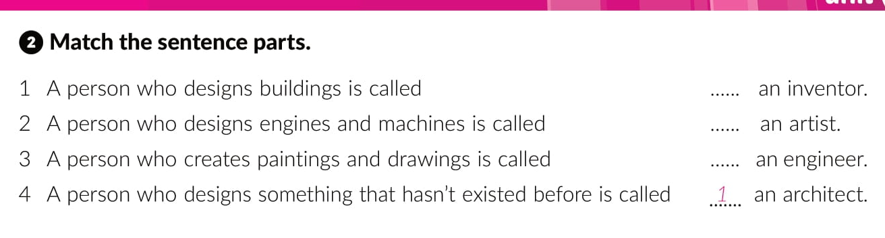
4
3
2

Slide 18
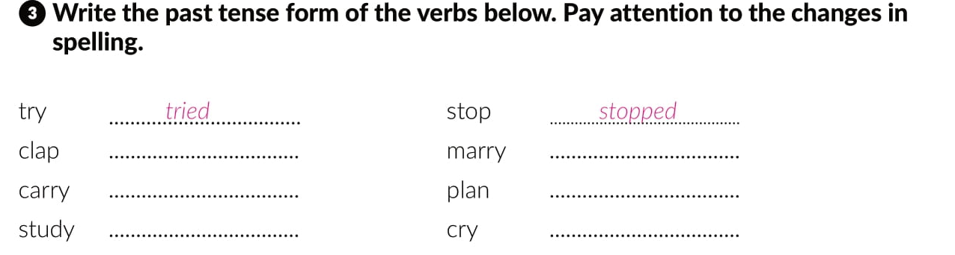
clapped
married
carried
planned
studied
cried

Slide 19
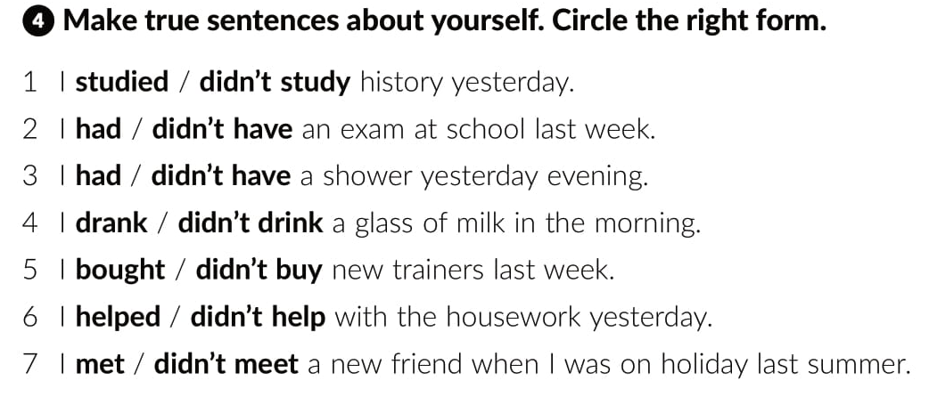

Slide 20
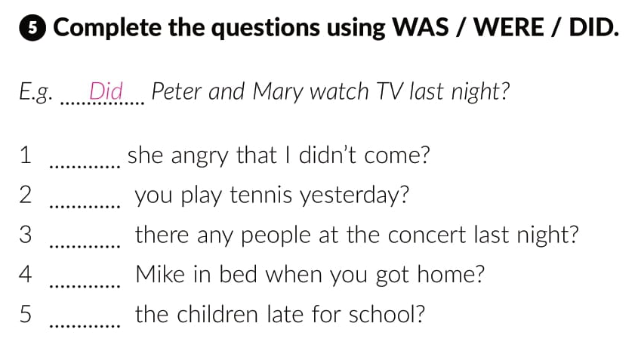
Was
Did
Were
Was
Were

Slide 21
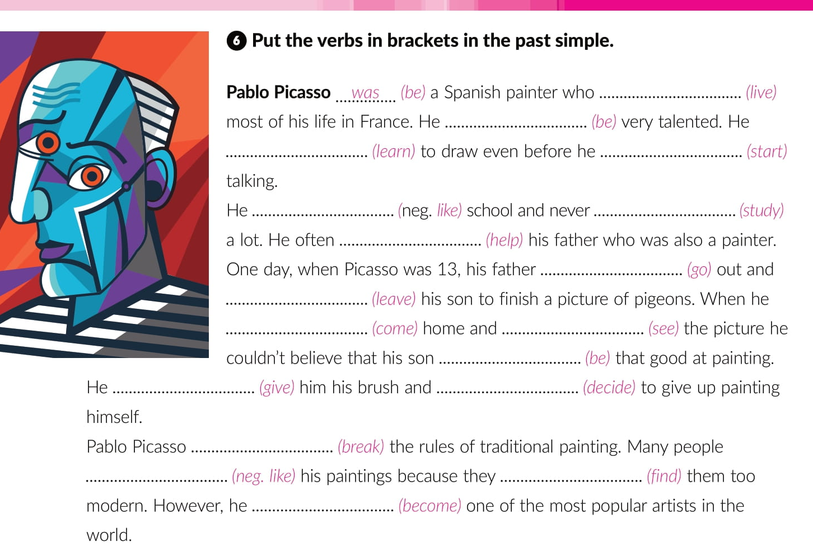
lived
was
learned
started
didn’t like
studied
helped
went
left
came
saw
was
gave
decided
broke
didn’t like
found
became

Slide 22
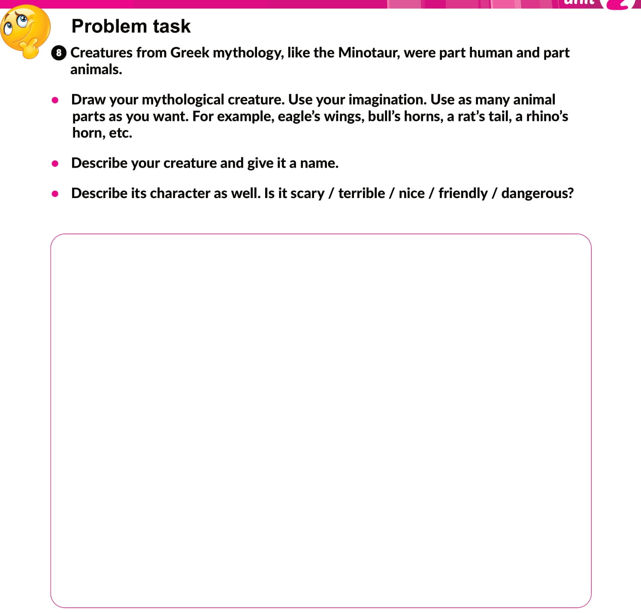
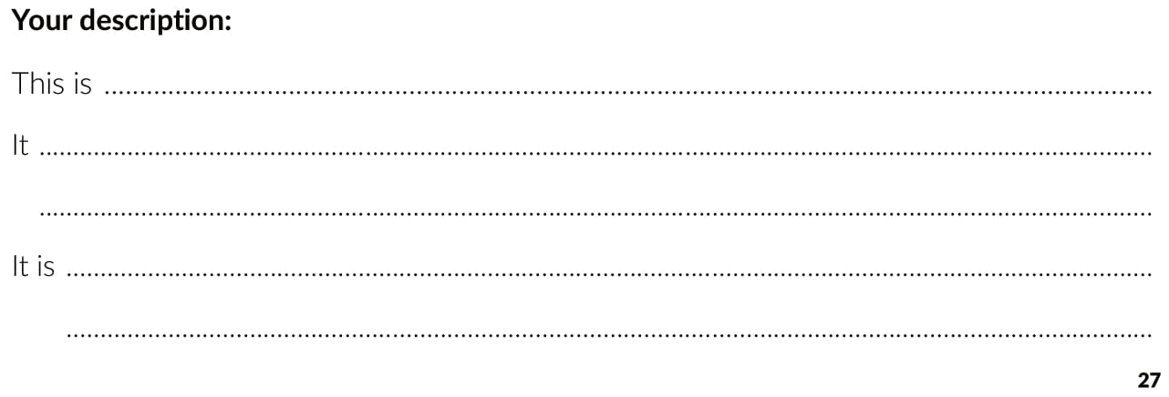

Slide 23

PLAY AND LEARN
https://www.e-sfera.hr/dodatni-digitalni-sadrzaji/aa2f10bb-5925-42d4-8337-a323a2b401c8/

